Slide 1
BIOMEDIN 215 Data Science in Medicine
Nigam Shah, MBBS, PhD
nigam@stanford.edu
Notes:
1.Schneeweiss S, Avorn J. A review of uses of health care utilization databases for epidemiologic research on therapeutics. J Clin Epidemiol 2005

Slide 2
Quick recap:
Research questions and study designs
Where and why are data generated?
Notes:
Key points from post lecture survey:
Study design & research question
relationship between the clinical study design and the question we ask
example of retrospective cohort .. 4.5 years of follow-up
Case control, why are they bad → Cross-sectional are bad. Case-control are not always bad … for rare events, they are sometimes the only thing we can do. However, because we define a case, and a corresponding non-case (i.e. a control) and then look back in time to find exposures .. The chances of biases creeping in are higher.
Comparison of different study designs
Inferential, predictive, causal … interpretation.
Advantage of a prospective cohort study over a retrospective cohort study
Bias
Control Selection Bias
Some sort of bias seems unavoidable in most settings. Is this true, and are we studying it primarily to be aware that it exists in our data?
How to address these biases in datasets/ any analysis we do.

Slide 3
Health Care Utilization Databases
How are these utilization databases created
Which are the popular utilization databases
What are the primary sources of errors
How to assess the utility of a data source

Slide 4
The rate of hospitalizations with a principal diagnosis of pneumonia decreased by 27% from 2003 to 2009 while in-hospital mortality decreased by 28%.
During the same period, rates of hospitalization for sepsis and respiratory failure with a secondary diagnosis of pneumonia increased by 178% and 9%, respectively.
What is going on here?
Notes:
Using a nationally representative database—the Nationwide Inpatient Sample—the authors found that the rate of hospitalizations with a principal diagnosis of pneumonia decreased by a relative 27% from 2003 to 2009 while in-hospital mortality decreased by 28%.
During the same period, rates of hospitalization for sepsis and respiratory failure with a secondary diagnosis of pneumonia increased by 178% and 9%, respectively.
When these 3 groups were combined, the authors’ assessment of trends in pneumonia admissions and mortality changed substantially, with a 12% relative decline in pneumonia related admissions and a 6% increase in mortality during the study period.
From, https://www.ncbi.nlm.nih.gov/pubmed/22474208, Sarrazin et al Finding pure and simple truths with administrative data.

Slide 5
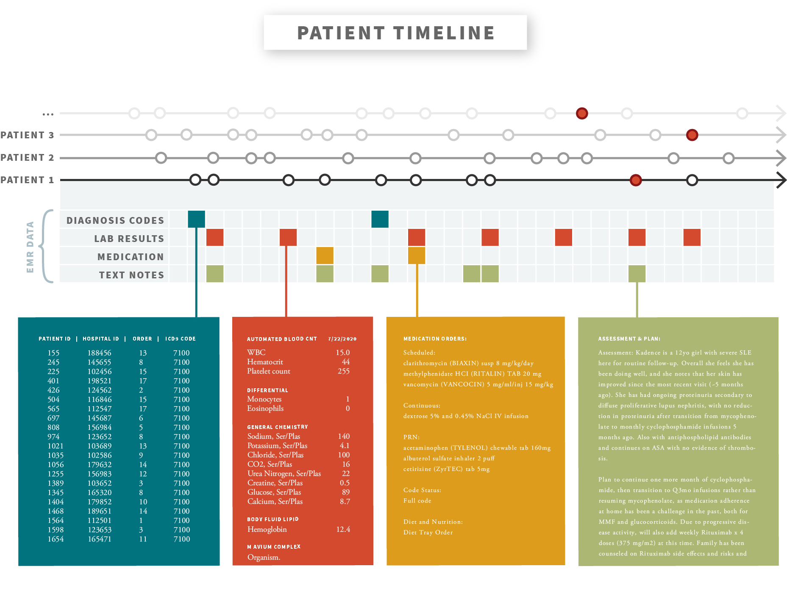
A patient timeline has multiple types of data
What gets recorded is influenced by the “ecosystem”

Slide 6
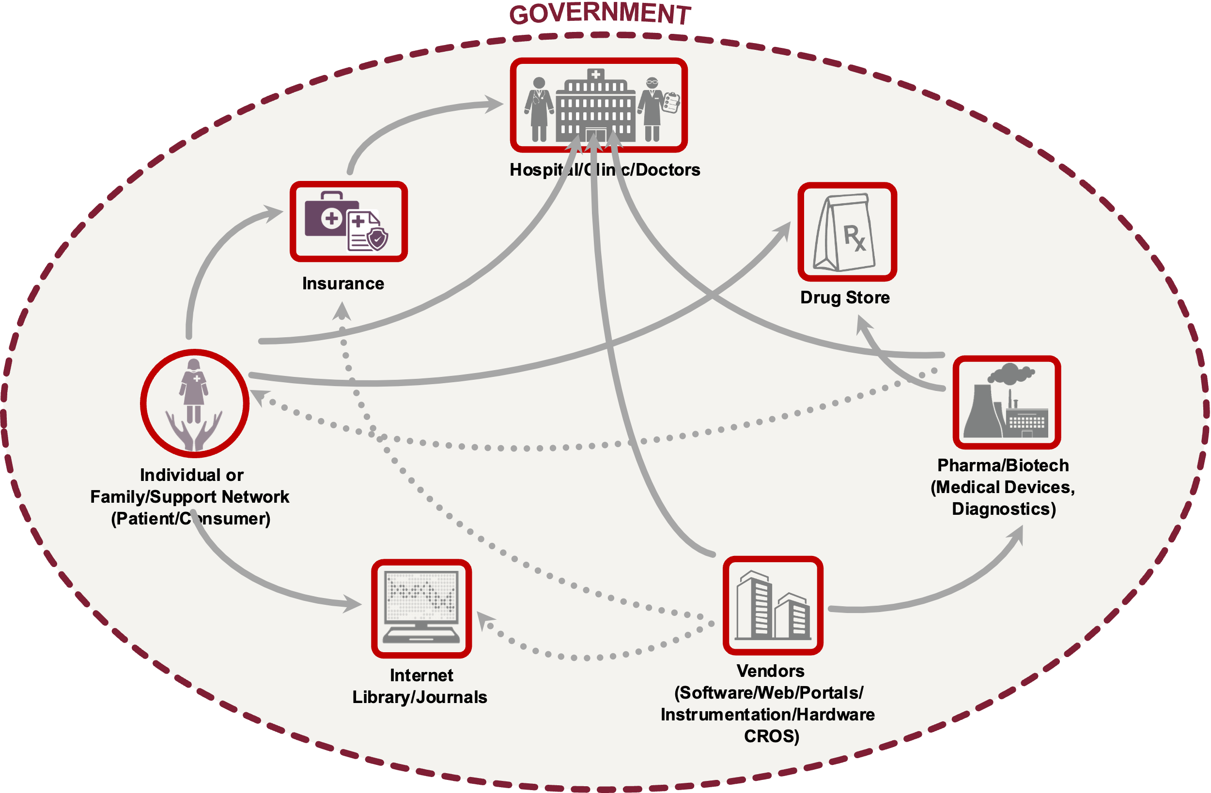
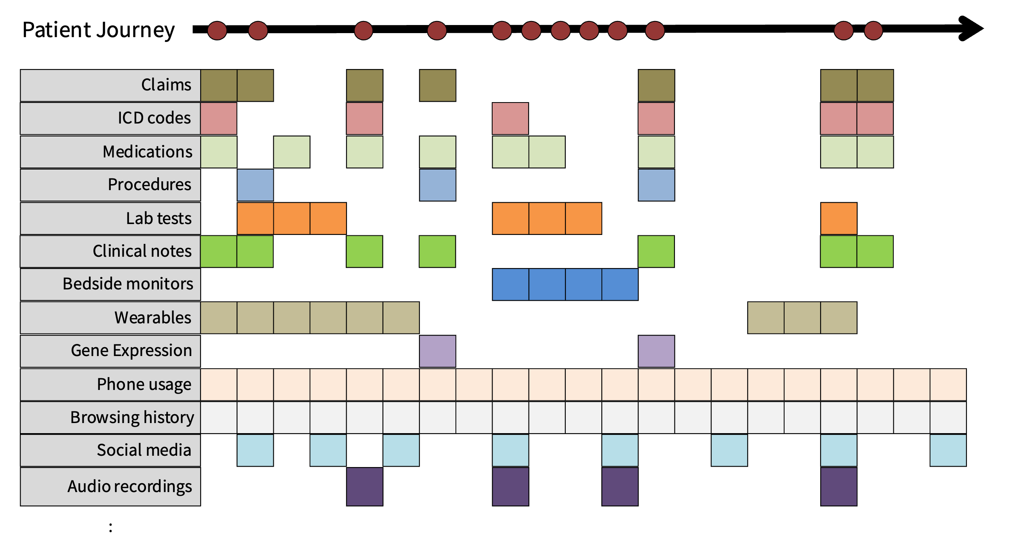
Remember how the incentives shape what is recorded!

Slide 7
Utilization is recorded in many ways
Notes:
PMID 24854141

Slide 8
Health Care Data Sources

Slide 9
Type | Content | Example Source(s)
Hospital data
Insurance/billing data
Population health data
Patient-reported data
Research reports
Safety/surveillance data
Diagnosis and procedure codes, clinical notes, medication administration records, lab results, patient demographics
Hospital EHR systems, research datasets (e.g. MIMIC-III)
Diagnosis and procedure codes, insurance status, member enrollment, procedure and drug costs
CMS/Medicare, Optum Health, Truven MarketScan
Expenditures by treatment type, medical condition, geographic area; disease prevalence
AHRQ: National Inpatient Sample, MEPS, NHANES
Diagnoses, symptoms, treatments, outcomes (sometimes in lay language)
PatientsLikeMe, Inspire
Study inclusion/exclusion criteria, study results
Clinicaltrials.org, clinical journals
Adverse event reports, drug/device approvals and recalls
FDA, CDC, state and local governments

Slide 10
Hospital sources
Medical Information Mart For Intensive Care (MIMIC)
A database of health-related data from patients who stayed in critical care units of the Beth Israel Deaconess Medical Center
Cerner Health Facts
Database of > 9 years of medical records from multiple facilities
>1.3 billion lab results, > 84 million visits; > 151 million drug orders

Slide 11
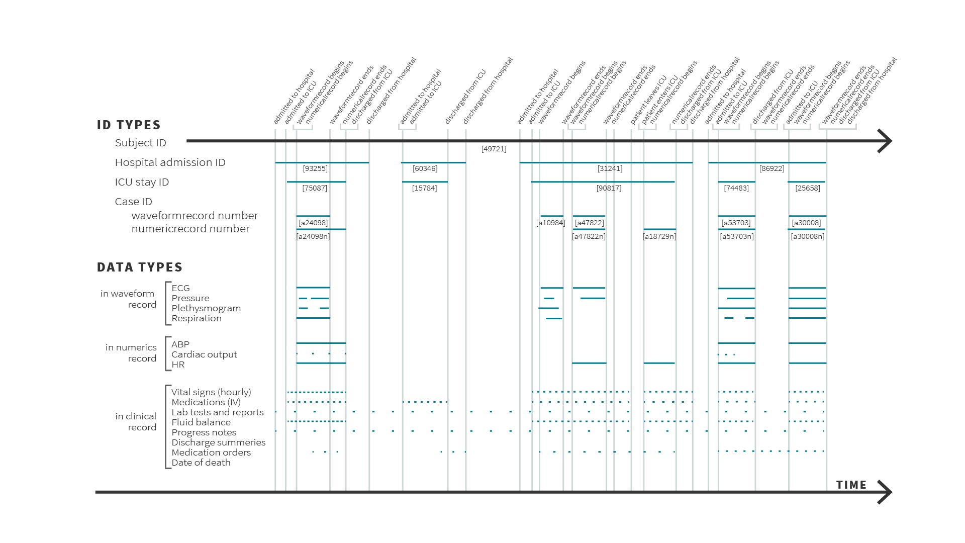
Patient timelines
Whether to treat
How to treat
Notes:
MIMIC-IV is grouped into three modules: core, hosp, and icu.
The core module stores patient tracking information necessary for any data analysis using MIMIC-IV. The core module contains three tables: patients, admissions, and transfers.
The hosp module contains data derived from the hospital wide EHR. These measurements are predominantly recorded during the hospital stay.
The icu module contains data sourced from the clinical information system at the BIDMC: MetaVision (iMDSoft).
The latest version of MIMIC is MIMIC-IV, which comprises over 58,000 hospital admissions for about 40,000 patients. The data spans 2008 - 2019.

Slide 12
Claims
Truven: 230 million people; 1995-2016
Optum: 56 million people; 2000-2016
Premiere: 700 hospitals;
Medicare/CMS
List at www.resdac.org/cms-data/file-availability
See what others have done www.dartmouthatlas.org
BCBS Axis: 100 million people; 2015 - ?
www.bcbsaxis.com
Notes:
Truven MarketScan Database:
The Truven Health MarketScan® Research Databases contain individual-level, de-identified, healthcare claims information from employers, health plans, hospitals, Medicare, and Medicaid programs. Data from individual patients are integrated from all providers of care, maintaining all healthcare utilization and cost record connections at the patient level from over 350 payers. Stanford has licensed data from 2007 - 2014, and we have access to roughly 159 million individuals’ data.
Optum Clinformatics Data Mart:
The Clinformatics Data Mart (CDM) is a database comprised of administrative health claims for members of a large national managed care company affiliated with Optum. The data span service dates beginning May, 2000 through the present date. The database includes approximately 12-14 million annual covered lives, for a total of roughly 56 million unique lives over a 14+ year period (5/2000 thru 12/2014); including results for outpatient lab tests processed by large national lab vendors. The population is geographically diverse, spanning all 50 states. Stanford has licensed data from 2003-2014, covering about 30 million unique lives.
Premier Inc:
Premier Inc. (NASDAQ: PINC) is a healthcare improvement company uniting an alliance of approximately 3,750 U.S. hospitals and 130,000 other providers. Our mission is simple: To improve the health of communities. As an industry leader, Premier has created one of the most comprehensive databases of actionable data, clinical best practices and efficiency improvement strategies. Premier Research Services leverages the HIPAA-compliant Premier healthcare database – which provides broad and detailed insights from over 700 U.S. hospitals with comprehensive billing, cost, device, medication and procedure data – to help pharmaceutical companies and device manufacturers
Medicare:
Stanford’s purchased subset = 11 million people; 2006-2013

Slide 14
Population Health data
Agency for Healthcare Research and Quality (AHRQ)
National Inpatient Survey
Medical Expenditure Panel Survey
National Health and Nutritional Examination Survey (NHANES)
Surveys conducted in the US by the Centers for Disease Control and Prevention to measure health and nutrition

Slide 15
Patient reported
Inspire
Social network organized around medical conditions and diseases where users can share their experience with disease and treatment
Patients Like Me
Online portal for patient-reported information about conditions, symptoms and treatments
Data are used in research studies

Slide 16
Research reports
Clinical Trials data
Clinicaltrials.gov
Case reports in journals
Disease and treatment registries
e.g. American Joint Replacement Registry (AJRR); National Cancer Institute Surveillance, Epidemiology, and End Results (SEER) Program
Notes:
Registries are tricky -- https://www.ncbi.nlm.nih.gov/books/NBK208643/
Registry of Patient Registries -- https://www.ahrq.gov/ropr/index.html ended in 2019.
2017, landscape of registries = https://www.ncbi.nlm.nih.gov/pmc/articles/PMC5994955/

Slide 17
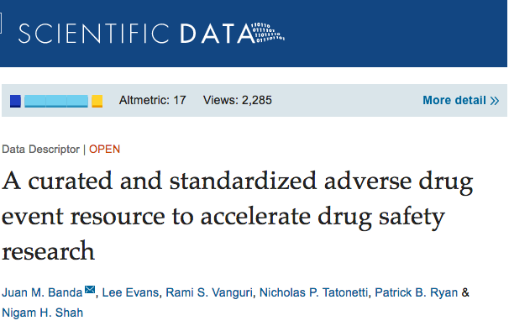
Surveillance data
Food and Drug Administration (FDA)
FDA Adverse Event Reporting System (FAERS)
Manufacturer and User Facility Device Experience (MAUDE)
Centers for Disease Control and Prevention (CDC)
Local and state governments

Slide 18
What are the primary pros and cons of health care databases as compared to prospectively collected data?
Raise hands

Slide 19
Pros and cons of health care databases
Pros
Large size → ability to study rare events
Representative of routine clinical care → study real-world effectiveness and utilization
Available at relatively low cost without long delays → accessible and efficient
Cons
Static - difficult to obtain additional features/detail
Patient records not always linked
Data creation and collection are imperfect and biased
A record exists only if something [bad] happens.

Slide 20
Understanding the primary sources of errors

Slide 21
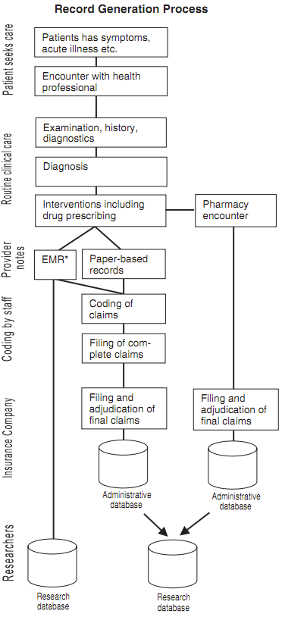
Breakout:
On the right is a path that patient data takes through the health care system.
Follow the flowchart, and write down what errors might get introduced in the data at each step

Slide 22
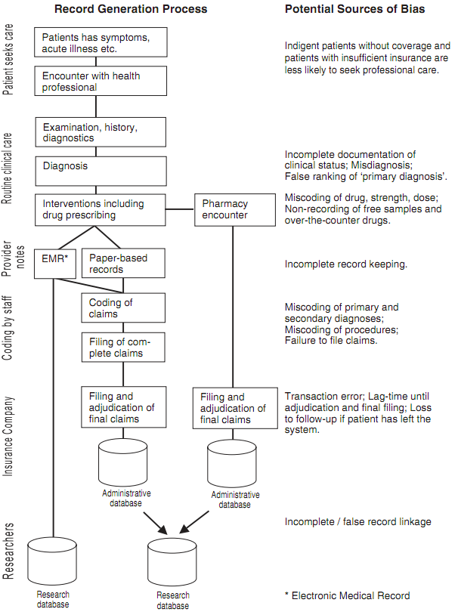
Sources of Error
Selection bias
Misclassification bias
Missing data (unobserved confounding, low predictive power)
Selection bias, misclassification bias
Selection bias, missing data bias
missing data bias
Notes:
Uninsured
Misdiagnosis, Miscoding of drugs
Incomplete record keeping
Miscoding of diagnosis
Loss to follow-up
Incomplete/false record linkage
Things are better recorded when they’re worth money.
Figure 1 in https://pubmed.ncbi.nlm.nih.gov/16178999/ is worth looking at.

Slide 23
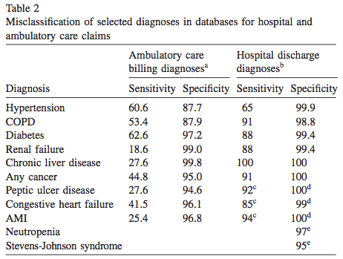
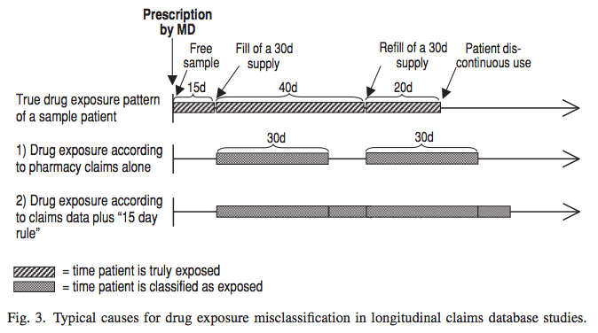
Errors lead to biases
 | disease (outcome) | no disease
exposed (treatment)
not exposed
Notes:
If the calculated or pharmacist-recorded days supply is too short or if patients decide to stretch a prescription by using a lower dose (e.g., tablet splitting), some person-time will be classified as unexposed when it truly is exposed. Most chronically administered drugs are used for longer periods, resulting in multiple refills. A patient can thus be classified as being unexposed intermittently despite continuous exposure. Many investigators therefore extend the calculated days supply by some fraction (e.g., 50% or 15 days in Fig. 3 [strategy 2]) to avoid this misclassification.
Drugs taken sporadically are particularly difficult to model accurately- missing data leads to misclassification
Complications that occur during hospital stays are often miscoded as comorbidities. A recent validation study found that the sensitivity of coding clinical complications is usually less than 50%. However, because the prevalence of complications is fairly low, this may not cause major distortions in most settings

Slide 24
Dealing with misclassification biases
Require the occurrence of disease-specific procedure codes or minimum length of stay requirements
Chart review: validate with patient’s primary medical record
Assess the effect of misclassification
Simulation Extrapolation (SIMEX): add random misclassification to the observed exposure or outcome measurements, assess effect on primary study findings
Electronic phenotyping is all about avoiding misclassification biases

Slide 25
Keep healthy skepticism
(about observational healthcare data sources)

Slide 26
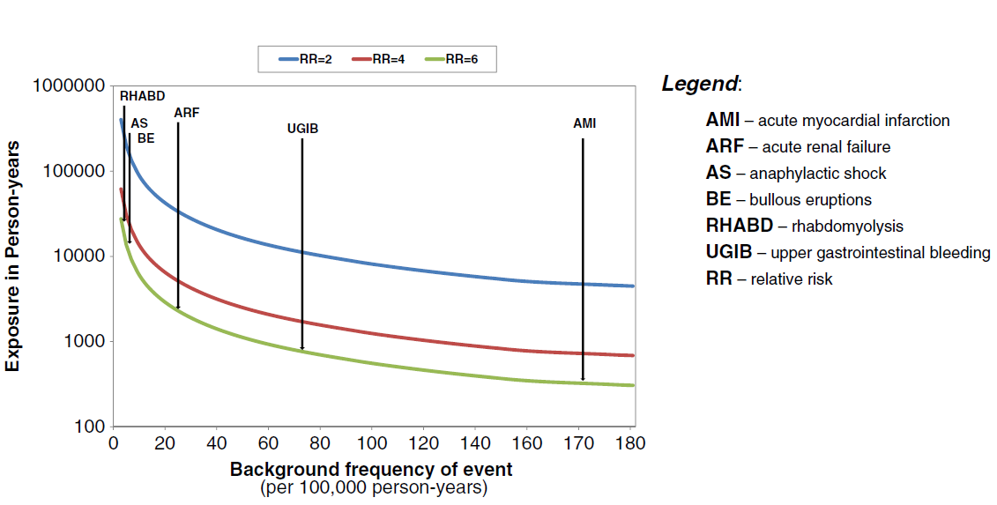
Rare events: are there enough data?
Coloma et al, Pharmacoepidemiology and drug safety (2012)

Slide 27
Are these data usable?
documented data model (how are they organized)
known provenance (where do the data come from)
usability (how can they be accessed)
quality (where are there errors)
Are they useful for my question?
outcomes and exposures recorded
variables and predictors recorded
enough data for rare events
proxies for 1-2
Notes:
adapted from: https://academic.oup.com/jamia/article-abstract/doi/10.1093/jamia/ocx095/4108095/A-conceptual-framework-for-evaluating-data?redirectedFrom=fulltext
Other questions to ask:
Data model: how does the source store what relates to what
Terminologies: what terms does the source use to denote specific items in the data
Level of Quality Control: what are the tests and checks to ensure that the right terms are used, and the right things relate.
Counting outcomes of interest: How will you decide if ‘X’ happened or not.

Slide 28
Obtaining Healthcare Utilization data
Pay money to buy data
Become a member of a club (a.k.a. “research network”)
Check out https://med.stanford.edu/sdsr.html
New trend: Obtain data directly from patients
PicnicHealth
Ciitizen
others …

Slide 29
Assigned reading
Casey JA, Schwartz BS, Stewart WF, Adler NE.
Using Electronic Health Records for Population Health Research: A Review of Methods and Applications.
Annu Rev Public Health. 2016;37:61-81. PubMed PMID: 26667605
Ning Shang, Chunhua Weng, George Hripcsak
A conceptual framework for evaluating data suitability for observational studies
Journal of the American Medical Informatics Association, Volume 25, Issue 3, March 2018, Pages 248–258, https://doi.org/10.1093/jamia/ocx095

Slide 30
Self study material

Slide 31
Shopping for healthcare data
Just need a credit card!

Slide 32
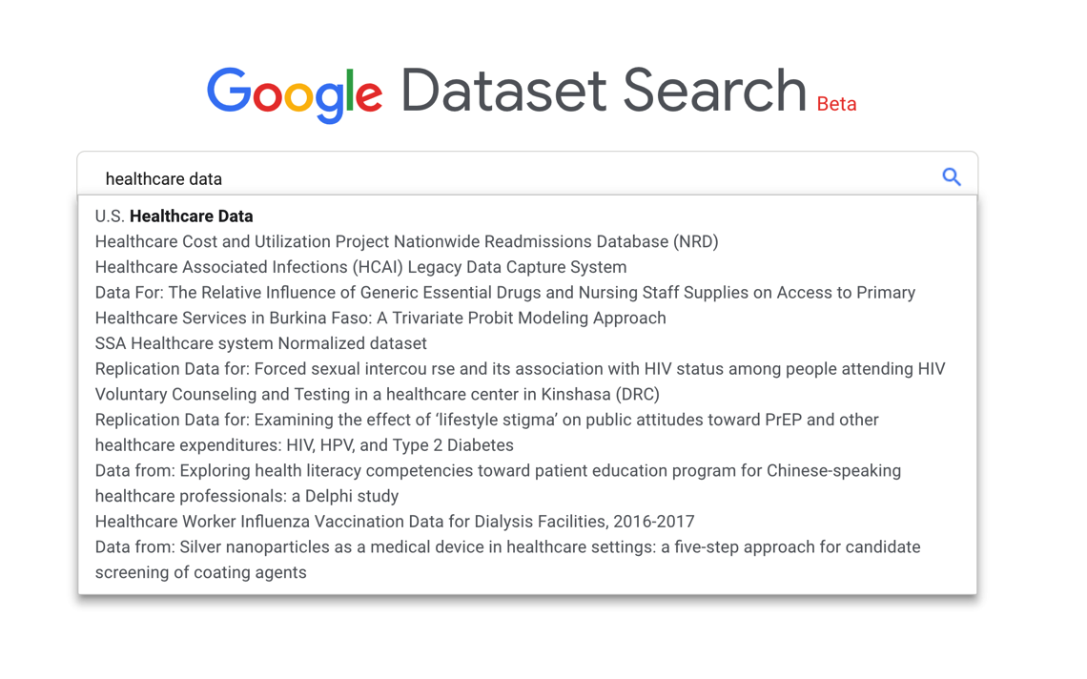
https://toolbox.google.com/datasetsearch

Slide 33
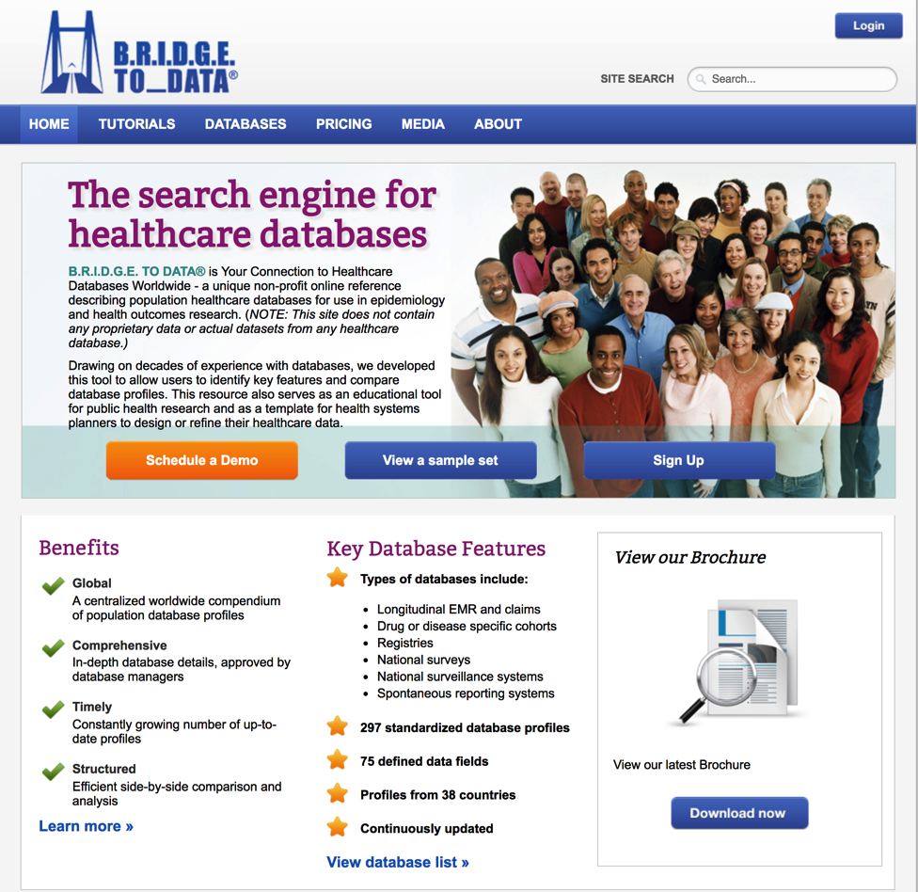
www.bridgetodata.org
Notes:
89 datasets are from USA.

Slide 34
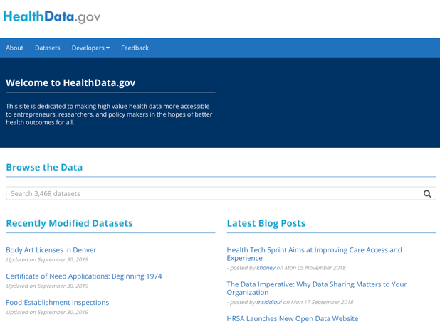
www.healthdata.gov

Slide 35

www.healthverity.com

Slide 36
Research networks
Clubs you could become a member of

Slide 37
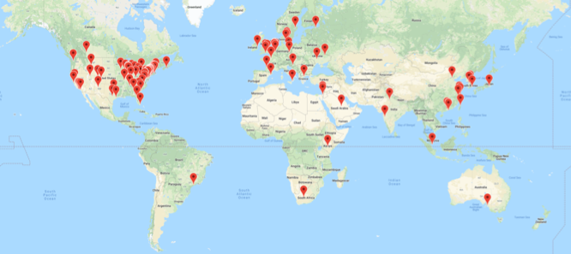
www.OHDSI.org
Tools -- https://github.com/OHDSI
Methods -- https://ohdsi.github.io/MethodsLibrary/
Data -- www.ohdsi.org/web/wiki/doku.php?id=resources:2019_data_network
Notes:
OHDSI addresses one weakness of observational data, which is that it can be difficult to aggregate, and also enhances one strength, which is that there can be a lot of it

Slide 38
PCORNet
11 Clinical Data Research Networks
(CDRNs)
PCORnet:
A national infrastructure for patient-centered clinical research
18 Patient-Powered Research Networks
(PPRNs)
Notes:
PCORI is funded through the Patient-Centered Outcomes Research Trust Fund (PCORTF), which was authorized by Congress as part of the Patient Protection and Affordable Care Act of 2010 and receives income from two funding streams: the general fund of the Treasury and a small fee assessed on Medicare, private health insurance and self-insured plans.
PCORI is expected to receive an estimated $3.5 billion from the PCORTF to fund patient-centered outcomes research through September 30, 2019, the date through which the Act authorizes it to remain in operation.
For government fiscal years (FYs) 2010–2012, the PCORTF received $210 million total in appropriations from general fund revenues.
For FY 2010, $10 million
For FY 2011, $50 million
For FY 2012, $150 million
For FY 2013, the PCORTF will receive $150 million from the general fund in appropriation plus an annual $1 fee per individual assessed on Medicare and private health insurance and self-insured plans. The combined estimated total is $320 million.
For FYs 2014-2019, the PCORTF will receive $150 million from the general fund in appropriation plus an annual $2 fee per individual assessed on Medicare and private health insurance and self-insured plans and an adjustment for increase in healthcare spending. The combined estimated total averages $650 million per year.
Each year, 20 percent of PCORTF funding is directed by the law to be transferred to the Department of Health and Human Services to support dissemination and research capacity-building efforts. Eighty percent of that amount is transferred to the Agency for Healthcare Research and Quality for these purposes.
Additional details on how PCORI is funded are provided in the authorizing law in Sec. 1183 and Sec. 9511, beginning on page 15 of this PDF.
Latest at: http://www.pcori.org/about-us/annual-reports-and-financials/how-were-funded

Slide 39
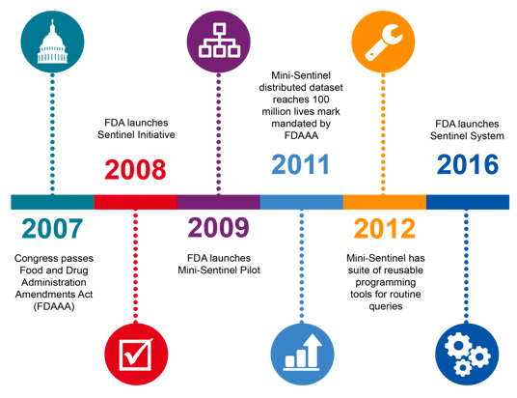

Sentinel
Notes:
The Sentinel Initiative began in 2008 as a multi-year effort to create a national electronic system for monitoring the safety of FDA-regulated medical products.
The Initiative is the FDA’s response to the Food and Drug Administration Amendments Act (FDAAA) requirement that the FDA work with public, academic, and private entities to develop a system to obtain information from existing electronic health care data from multiple sources to assess the safety of approved medical products.

Slide 40
COVID-19 data networks
National COVID Cohort Collaborative (N3C), https://covid.cd2h.org/N3C via CD2H
Consortium for Clinical Characterization of COVID-19 by EHR - https://covidclinical.net/
Observational Health Data Sciences and Informatics, www.ohdsi.org/covid-19-updates/
COVID-19 Healthcare Coalition https://c19hcc.org/
COVID-NET by the CDC - https://gis.cdc.gov/grasp/COVIDNet/COVID19_5.html
COVID19 Research Database: https://covid19researchdatabase.org/
Aetion and HealthVerity opening to researchers - https://info.healthverity.com/covid-19
Epic’s take → www.ehrn.org

Slide 41
Center for Population Health Sciences
The best kept secret on campus!

Slide 42
